Slide 1
Energy Forecast & Activity Deviation Detection
Saquib Herman, Vijay Jayaraman
27th September, 2021
Notes:
We are group 3, Vijay and Caleb would like to present the paper - Connected Bike-smart IoT-based Cycling Training solution
I will explain the IoT architectual and VIjay will present you the analysis and security

Slide 2
Energy Forecast (Supervised Learning)
Business Question & Benefits-
Understand and analyse a person's energy consumption and forecast for the future.
Power companies to predict Power consumption of a locality.
About the Data-
Power data from appliances via smart plug sensors in the home environment.
Data available at 1Hz frequency

Slide 3
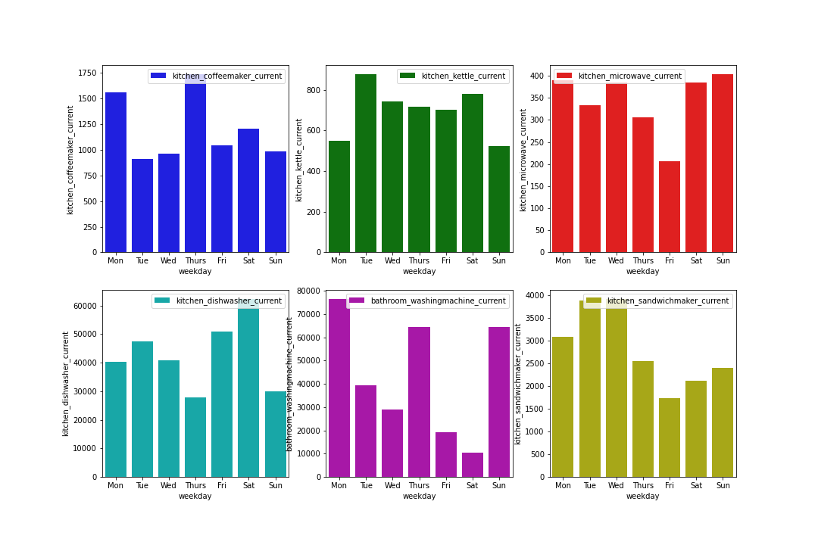
Understand Data with Visualisations

Slide 4
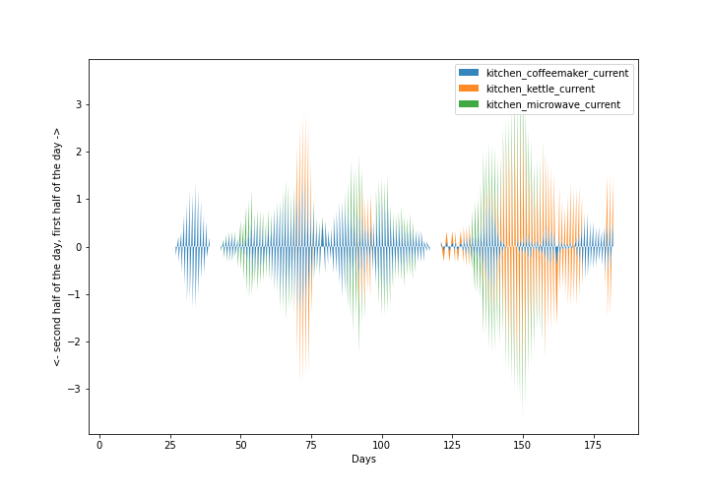
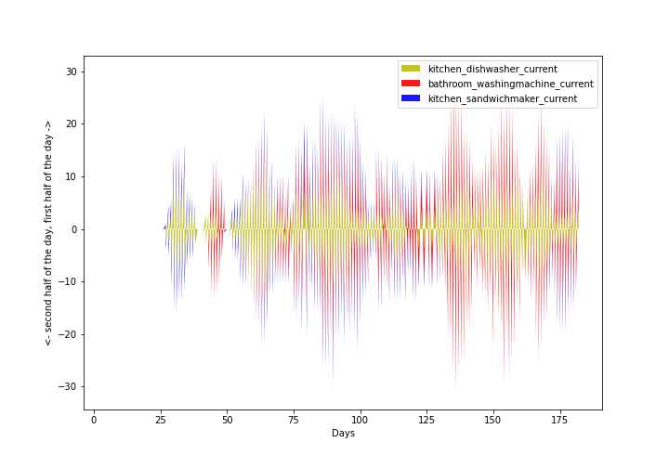
Understanding Data with Visualisation
Coffee current
Available in dense on for about 30 days
The problem with rolling sensors
Sandwich maker unavailble during the same period

Slide 5
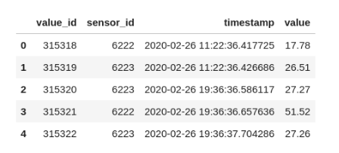
Data Wrangling (challenges)
Challenges
Data volume - 250 million samples from different sensors
Rolling sensors - sensors were placed on rolling period
Sparse Dataset - Slim window of activity relative to the entire dataset.
Noisy Data - High frequency nature of data (needs filtering or cleaning before modelling).
Time Formatting up to Milliseconds - holds no significance as the frequency of the points in the dataset is 1Hz.

Slide 6
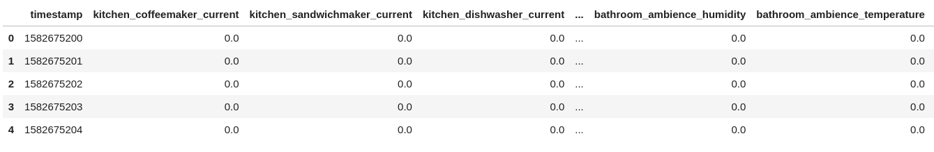
Data Preparation for Analysis (local)
Data transformed into having sensors as features and timestamps as the index. (250000000, 3)->(15000000,25).
Fitered millisecond and grouped by second
13GB -> 1.5 GB.
Creation of null values as sometimes the data is not sent by sensor leading to missing values

Slide 7
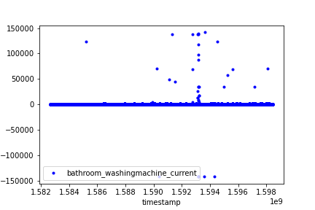
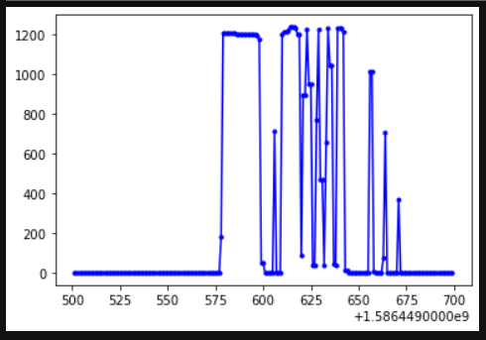
Data Cleaning
Challenges
Null values
Negative points & Noise points (As per rating of smart plug – 3.58 kW)¹
Gradual Increase to max value
Values don't fully go down to zero (This is an issue because issues in the sensor falsely increases power consumption)
Power value
Kitchen Coffee
Maker
Power value
timestamp
1. https://www.tp-link.com/se/home-networking/smart-plug/hs110/

Slide 8
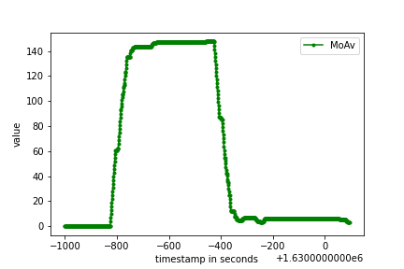
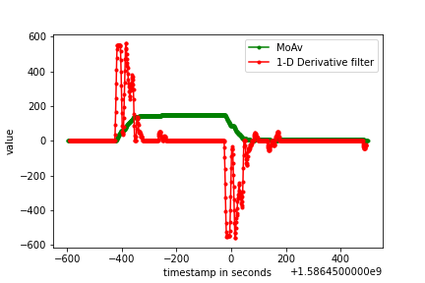
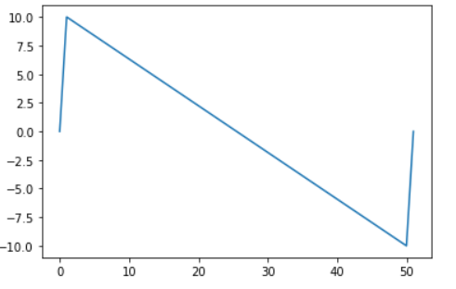
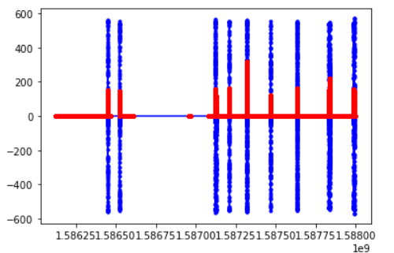
Filtering Process
ON
OFF
(Conv)
1-D derivative filter
Filter Parameters
1. Window Size = (10, 50)
2. Window range = (-10, 10)
Moving average ouptput
Filtered output
Use ffill method for null values
Filter noise points with Hard threshold of 4000
Moving average + 1-D Derivative filter to assist here.
Difference of almost 2.5 kwh after filtering the data
Filter parameters for different sensors manually chosen- window size & threshold for cutoff
After filtering and processing, we get 'on'/'off labels
Filtered Ouptut over wide range (Blue: Conv Output, Red: Mo-Av Output)

Slide 9
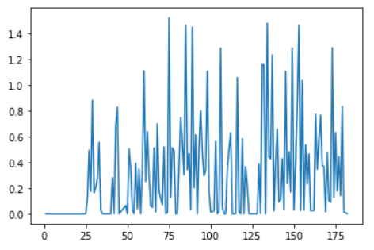
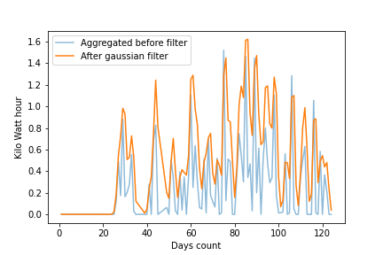
Data Preparation for Modelling
Cumulative data for each day based on the 'on'/'off' labels converted from on Watt-second to kilo-Watt-hour
Taking the first 125 days data to handle rolling sensors issue
Using raw aggregated data for modelling doesn't fit well.
Hence, Gaussian filter to filter out noise and smoothen the data before modelling.
Smoothens the data but can push the model to predict a little more
0.16 kWh MSE between filter and original values
Filter Parameters
1. Window Size-10
2. Std - 0.8

Slide 10
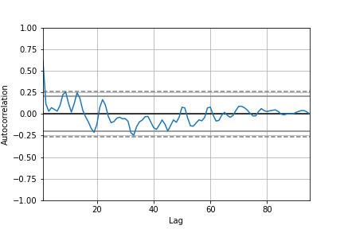
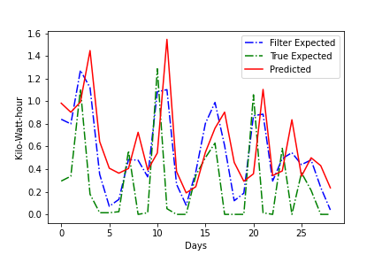
Modelling - ARIMA
- Parameters (2,0,1)
- Lag chosen using auto correlation plot
- Degree and window size chosen using Grid search over ranges (0,3)
Data-
1. Filtered Energy (kWh)

Slide 11
Modelling - Random Forest
Rndom

Slide 12
Results

Slide 13
Future Work
Automating the process of choosing the various filter parameters
Model Improvements ….
Improvement in sensor collection (rolling sensors)
Collect sensor data from other points like Mobile or laptop chargers which will make the prediction more realistic.
Conclusion
...

Slide 14
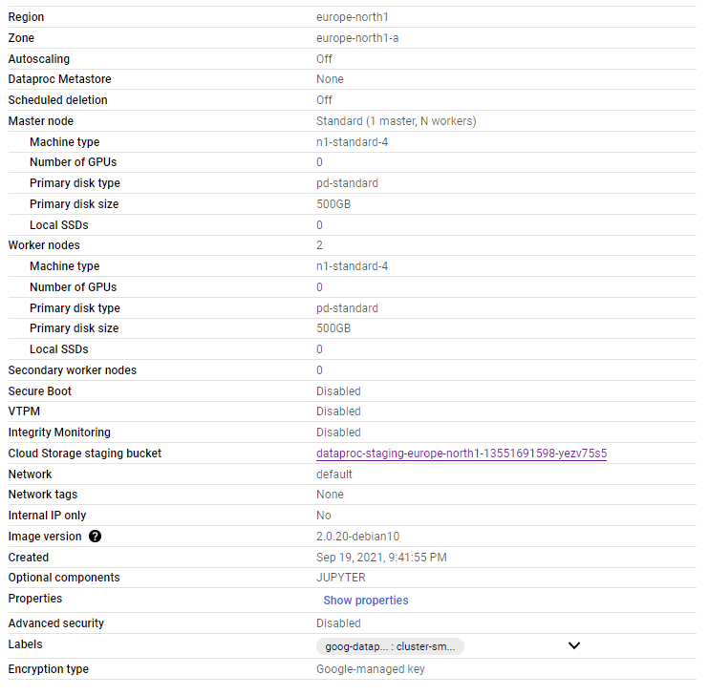
GCP and PySpark Configurations
1 Master node
2 Worker Nodes
PySpark version 3.1.2

Slide 15
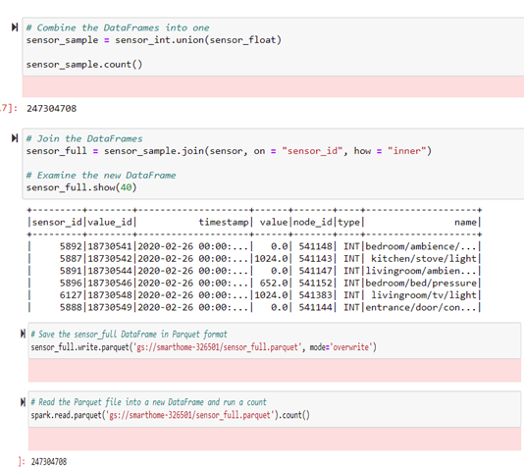
DATA PREPARATION
Does union of INT and FLOAT dataframes obtained from two different CSV files.
Perform “Join” resulting dataframe with the dataframe got from sensor.csv file.
Save the resulting dataframe as parquet format
Parquet file size is 3.7 GB whereas CSV files have size of more than 12 GB

Slide 16
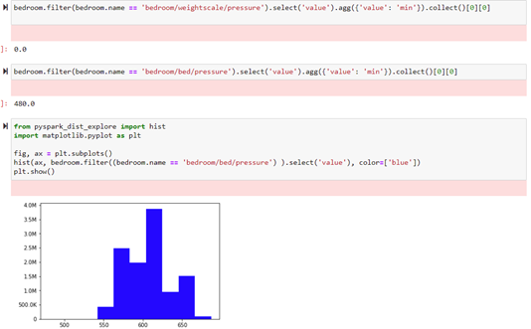
EXPLORATORY DATA ANALYSIS
Done initial analysis on each sensor data
Check min and max value of FLOAT sensors
Draw histograms

Slide 17
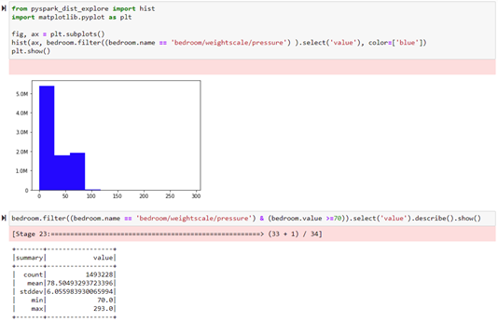
EXPLORATORY DATA ANALYSIS
Also check the parameters like mean, standard deviation and count

Slide 18
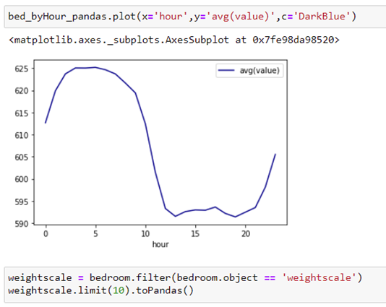
EXPLORATORY DATA ANALYSIS
GROUPBY hour and aggregated by value for bed pressure sensor
Initially this analysis is done for few sensors

Slide 19
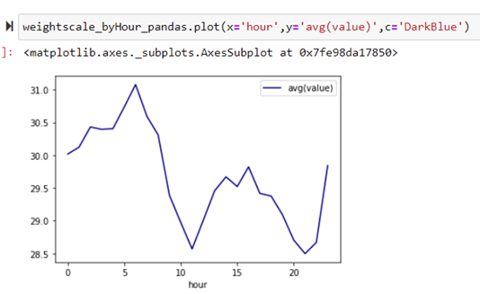
EXPLORATORY DATA ANALYSIS
Similar graph as last slide, this is for bedroom weight scale

Slide 20
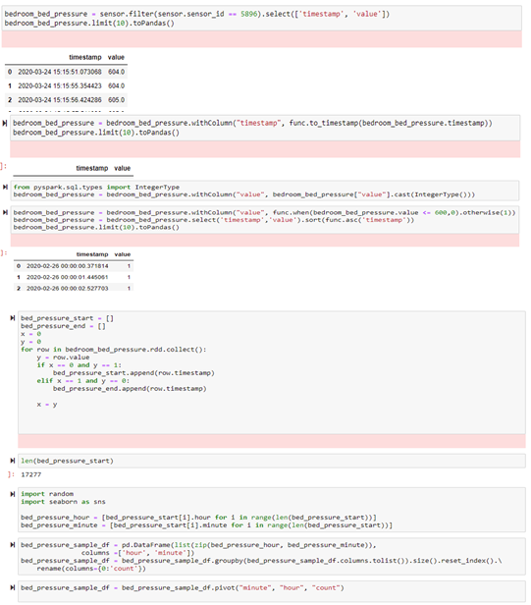
VISUALIZATION
Given code is the data preparation for creating the heatmap visualization
Sensor activation time and value is captured for the whole duration
This calculation is done for all sensor.
Later it is used for Sequence Mining also.

Slide 21
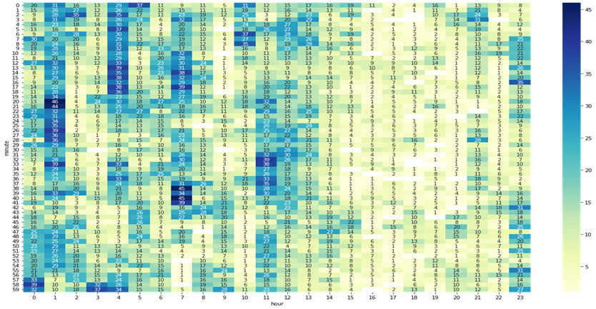
VISUALIZATION
HEATMAP for bedroom
Pressure sensor

Slide 22
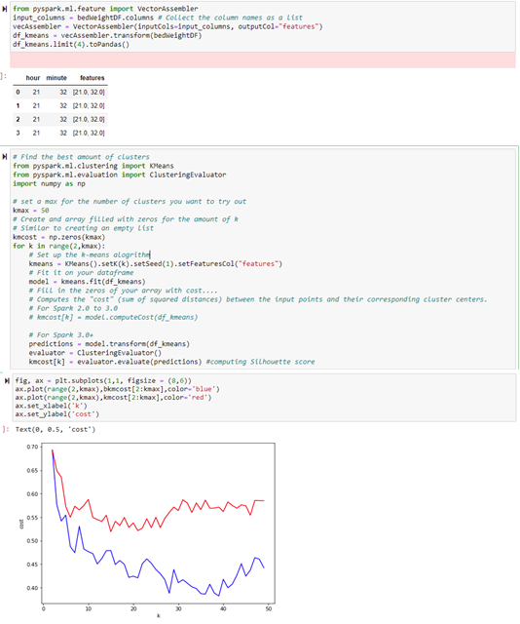
CLUSTERING
This clustering is done on individual sensors
Try to find the pattern of user's daily activity
Tried with K-Means, Bisect K-means and Gaussian Mixture Model
Compared K-Means and Bisect K-Means
Silhouette Coefficient is referred here as a method of interpretation and validation of consistency within clusters of data.
K-Means performs better here (Blue curve)

Slide 23
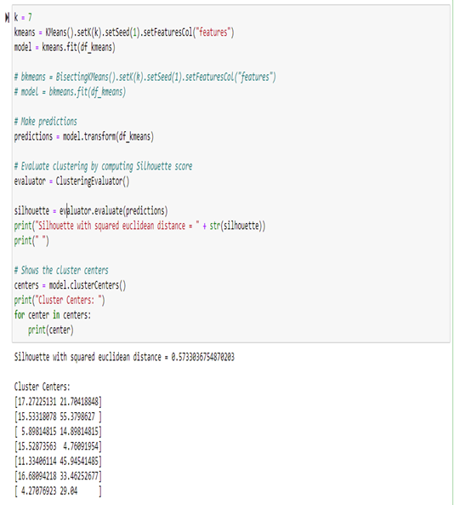
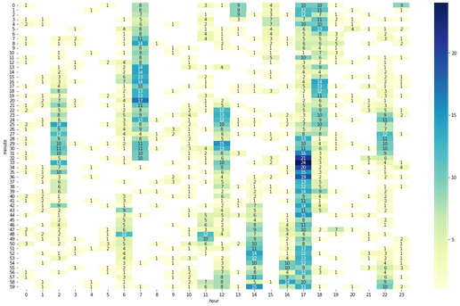
CLUSTERING
Side by side comparison

Slide 24
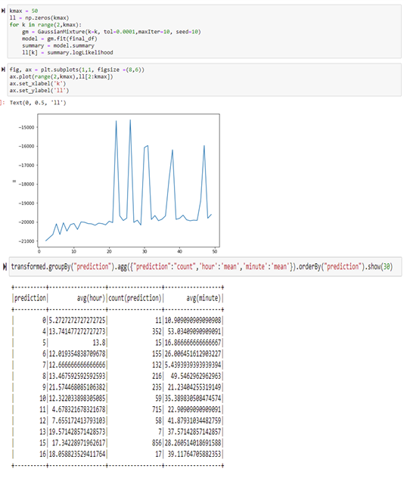
GAUSSIAN MIXTURE MODEL (Anisotropicly distributed data)

Slide 25
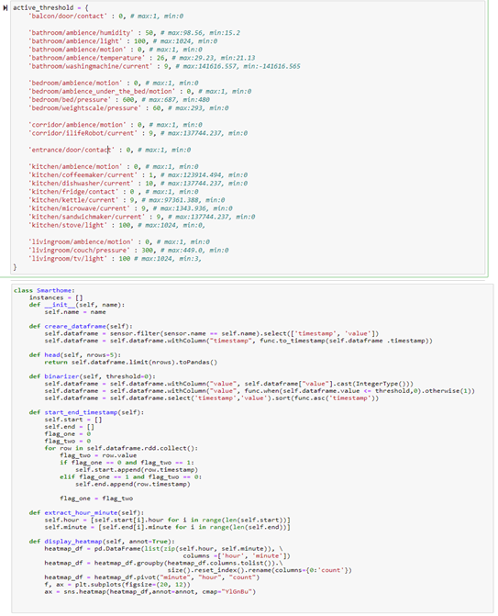
CODE RESTRUCTURING
Threshold values for each sensors is updated manually here (Hardcoded)
Class and functions created for better code readability and reusability

Slide 26
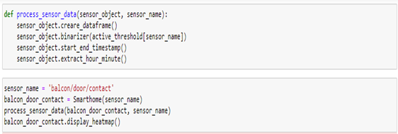
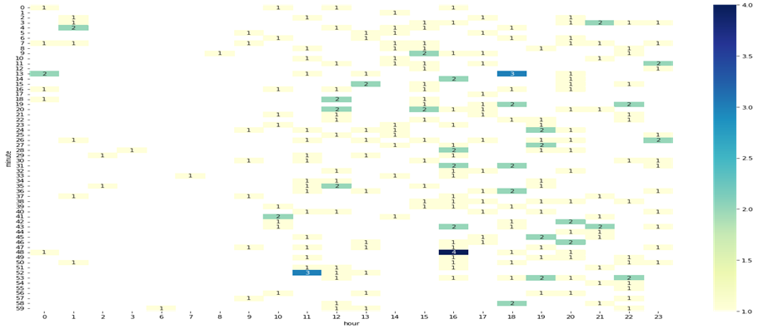
CODE RESTRUCTURING

Slide 27

SEQUENCE MINING

Slide 28
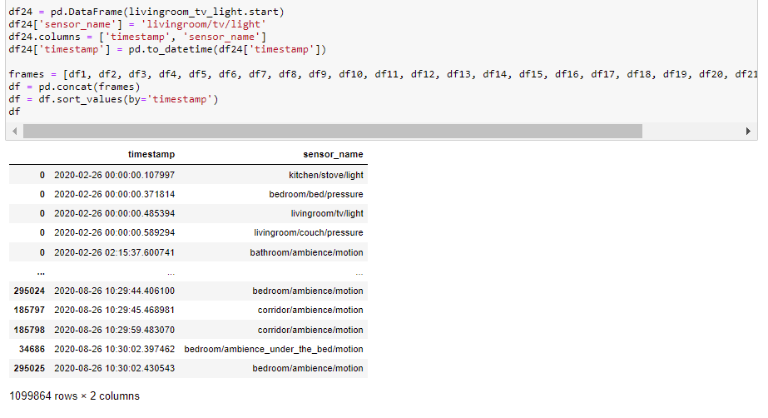
SEQUENCE MINING
Separate Dataframe is created for each sensor.
Each Dataframe is consisting two column, Timestamp and Sensor Name
Based on sensor start trigger

Slide 29
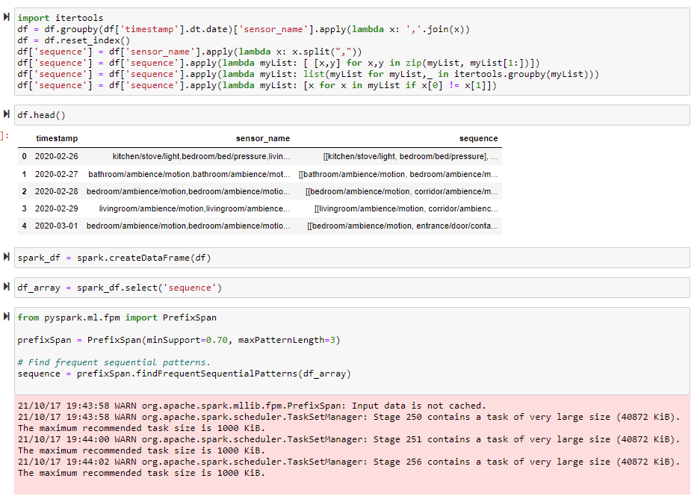
SEQUENCE MINING
Prepared the data for the Sequence Mining
Array of array is expected by PySpark's PrefixSpan
Also known as Frequent Pattern Mining

Slide 30
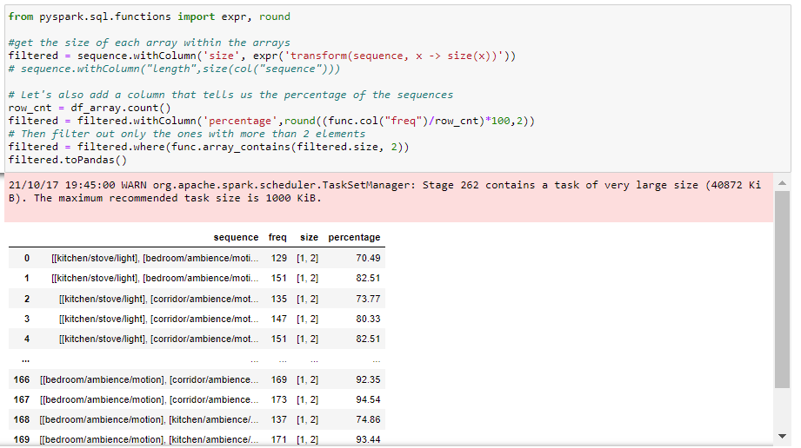
SEQUENCE MINING
Given output shows association for minimum support 0.7
Pattern length for 3
Bedroom Motion sensor and Corridor Motion sensor are highly associated

Slide 31
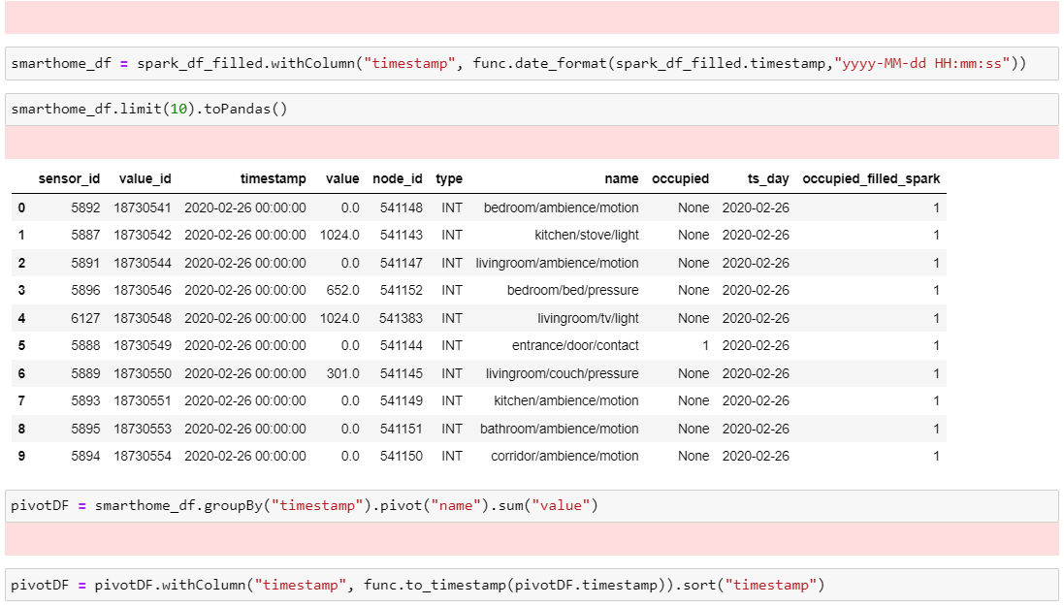
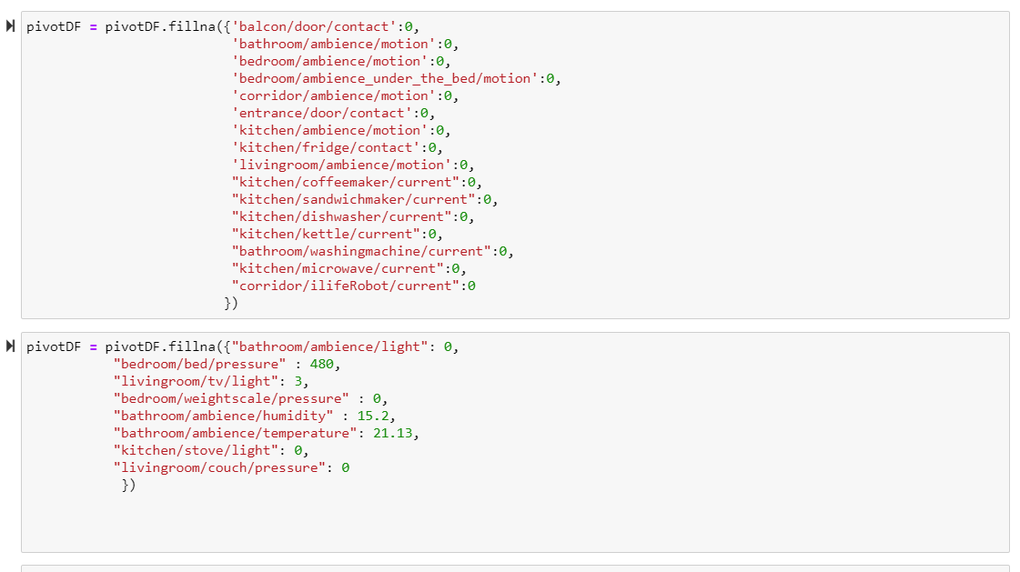
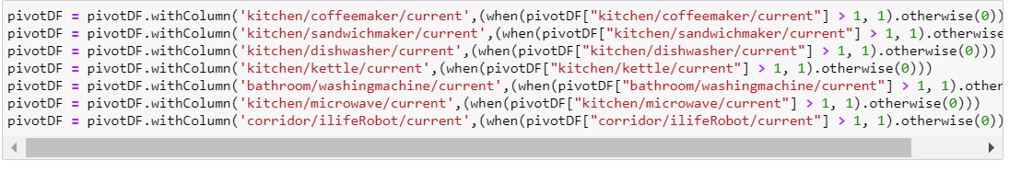
ACTIVITY CHANGE DETECTION USING CLUSTERING
Pivot the Dataframe as a part of data preparation for activity change detecting
Facing difficulty in filling the null values in PySpark so filled it with minimum value for each sensor
Since some FLOAT sensor mostly current ones are fluctuating so set it after threshold checks.

Slide 32
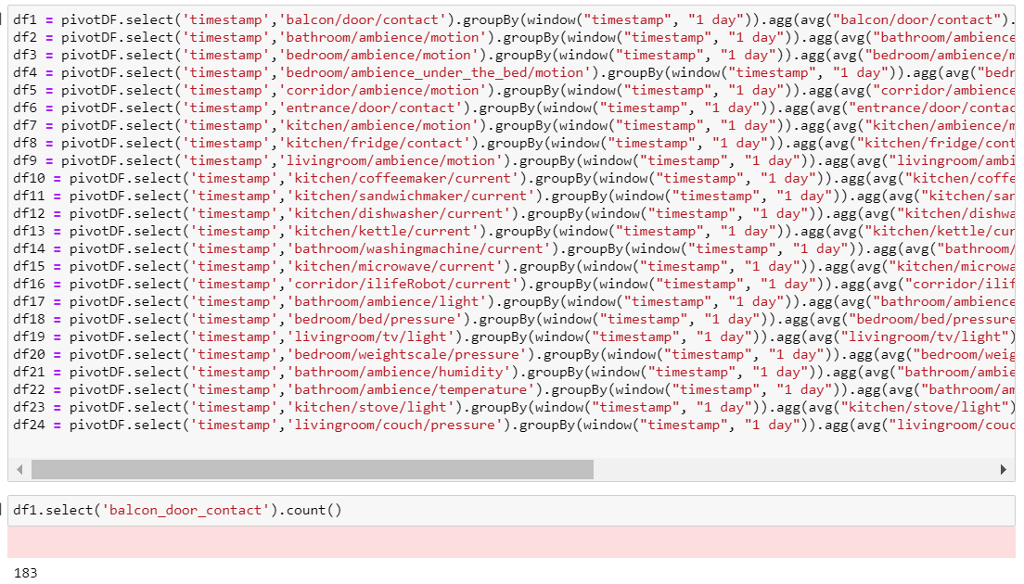
ACTIVITY CHANGE DETECTION USING CLUSTERING
Group-by by creating one day window with the aggregation function mean
It is done for all the sensors

Slide 33
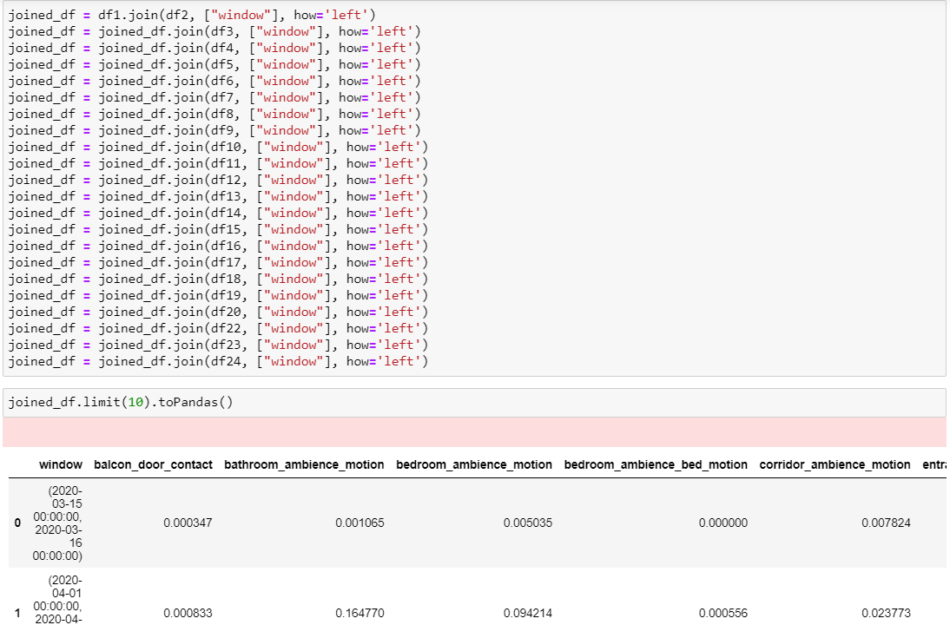
ACTIVITY CHANGE DETECTION USING CLUSTERING
Joined all the dataframe of each sensor on "windows" column
Total have 183 rows represents each day
All the columns have mean values for sesnors

Slide 34
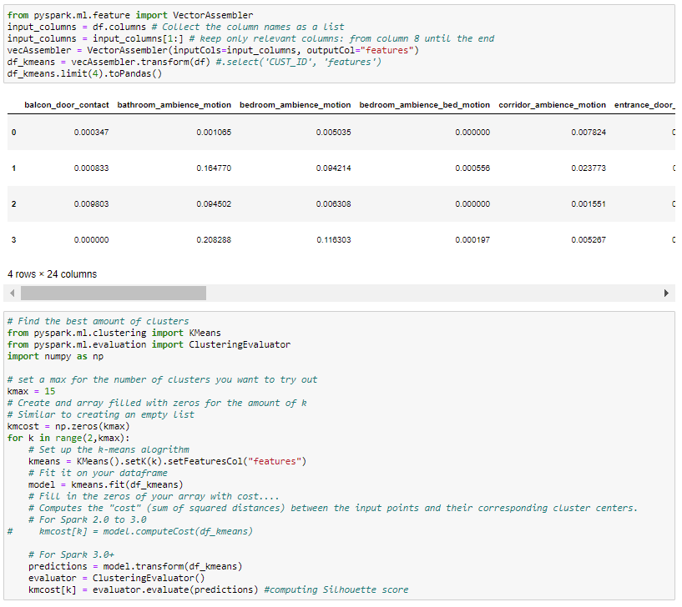
ACTIVITY CHANGE DETECTION USING CLUSTERING
Clustering algorithms are applied on prepared data of 183 days for all sensors represents as features
Again, applied K-Means and Bisect K-Means

Slide 35
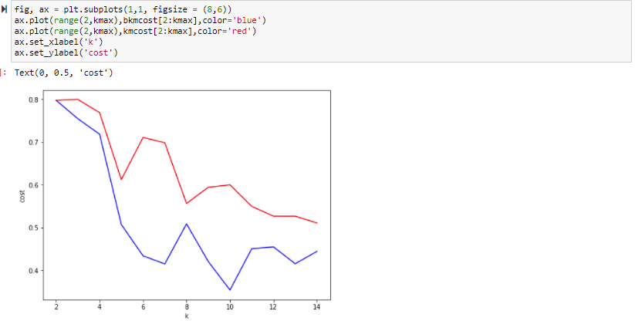
ACTIVITY CHANGE DETECTION USING CLUSTERING
Graph shows cost based on Silhouette score for both K-Means and Bisect K-Means
Here, Bisect K-Means performed better
Number of cluster would be 10

Slide 36
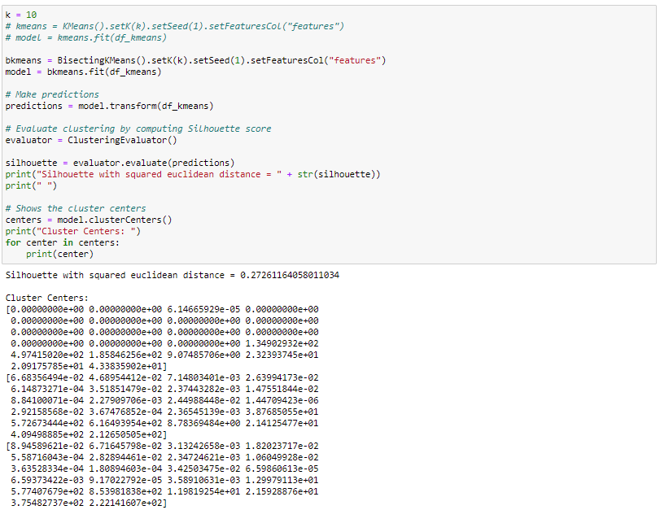
ACTIVITY CHANGE DETECTION USING CLUSTERING
This shows 10 different clusters or activities

Slide 37
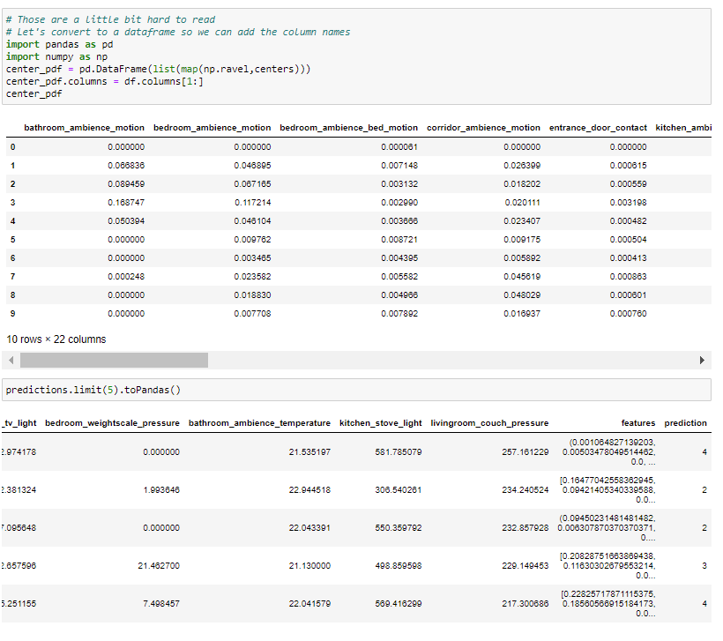
ACTIVITY CHANGE DETECTION USING CLUSTERING
Can predict each day belong to which cluster

Slide 38
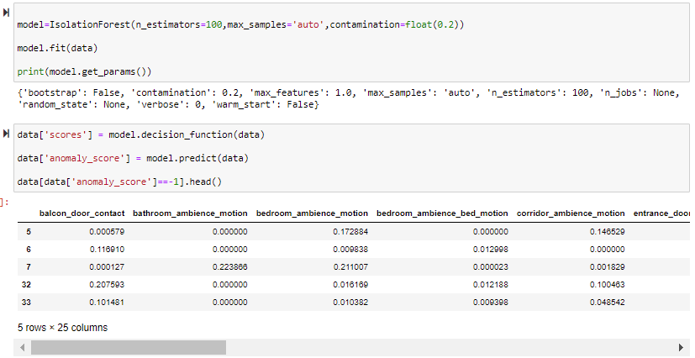
ANOMALY DETECTION
Used Isolation Forest to find Anomalies in given dataframe

Slide 39
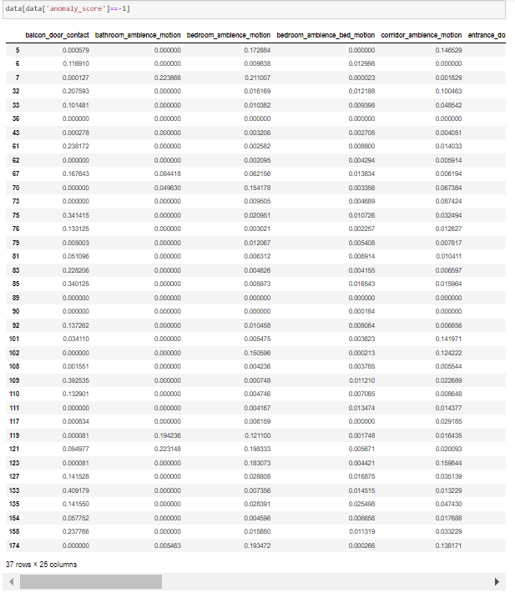
ANOMALY DETECTION
Total 37 days found to be as Anomalies

Slide 40
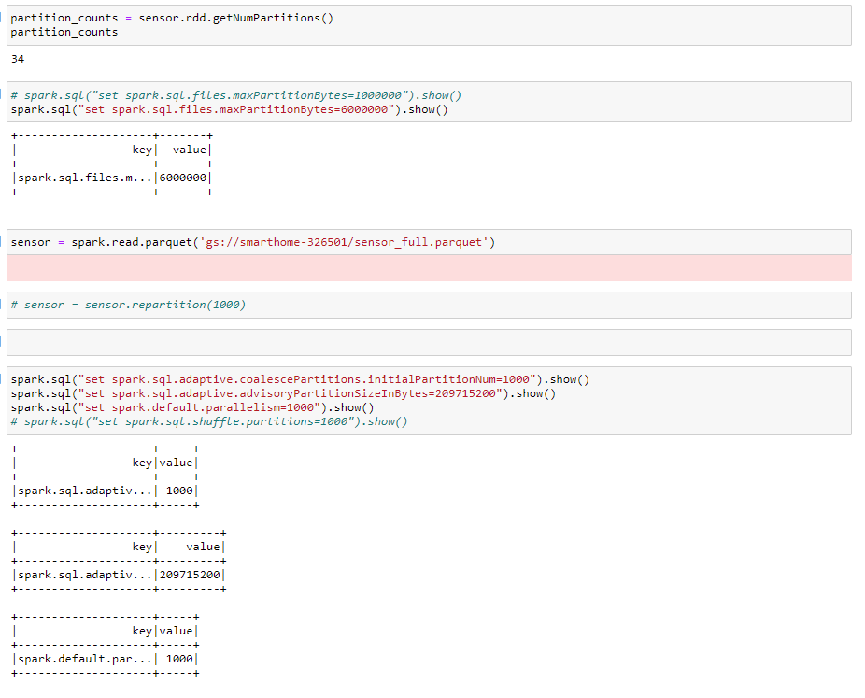
Supervised Leaning
Trying to predict whether resident about to leave the house or going to stay back
Labels need to be created
Two labels would be "About to leave" and "Stay back"
Frequent Pattern got from Sequence Mining can be used

Slide 41
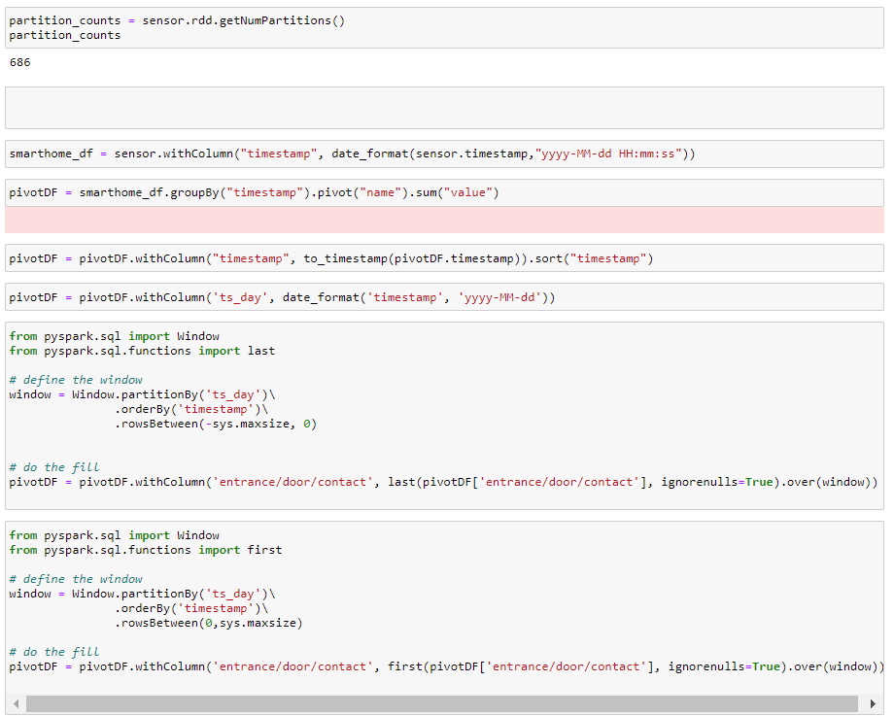
Supervised Learning
Data preprocessing is done here

Slide 42
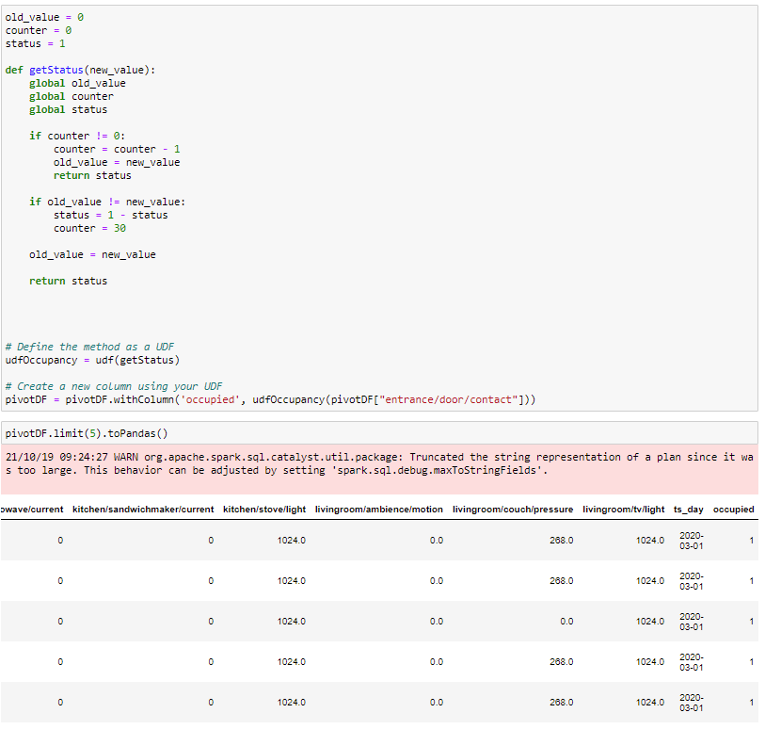
Supervised Learning
User defined function is created for creating new labels called "Occupied"

Slide 43
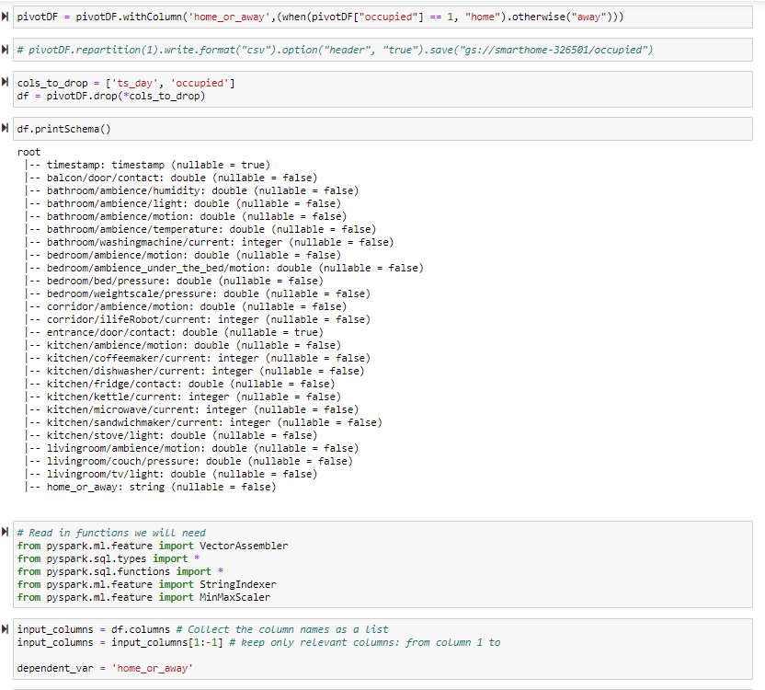
Supervised Learning
Created new column "home_or_away" based on "occupied"

Slide 44
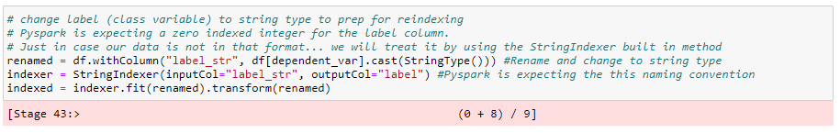
Supervised Learning
Not able to proceed from here
StringIndexer halts progress

Slide 45
Challenges Faced
Data Preparation – Bringing all sensors data in one dataframe
Filling null values as there is no direct support in PySpark
PySpark UDF behaves abnormally with Global Variables
Supervised Learning task ML execution not going through, needs performance optimization (still not fixed)

Slide 46
Q & A

